Slide 1


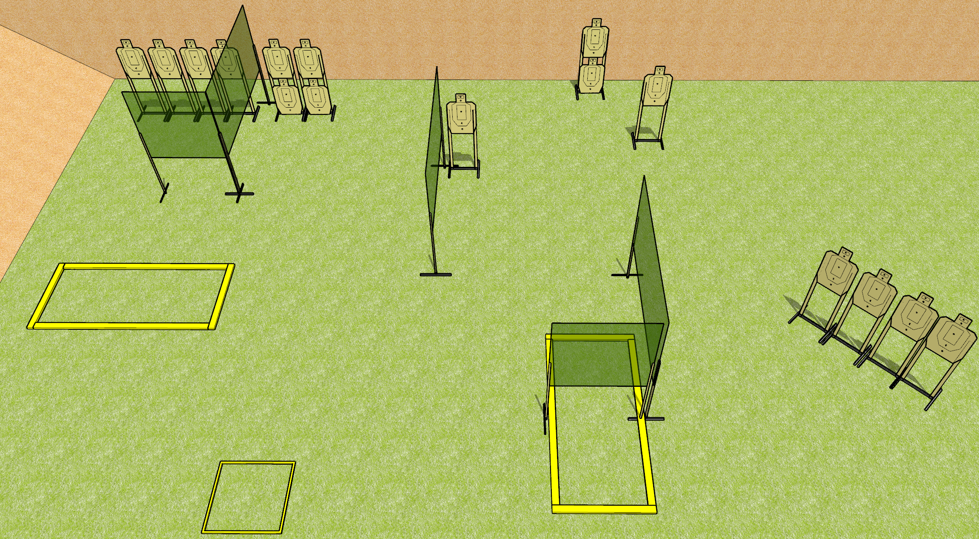
 | Dothan Gun Club – USPSA Match So you think you can hit factor Course Designer : Drew Coleman
Round Count 32 rounds 16 paper
Equipment List 8 wall feet 4 medium fault lines 4 8 foot fault lines

Slide 2
So you think you can hit factor
Written Stage Briefing
So you think you can hit factor is a 32 round, 160 point, Comstock field course. There are 16 USPSA targets. The best 2 hits on paper will score. The start signal is audible.
The start box is not part of the shooting area.
Handgun start position is in the starting box, wrists below belt. Handgun is loaded and holstered.
PCC start position is in the starting box. Loaded carbine is held with both hands, safety on.
On start signal, engage targets as they become available from within the shooting area.

